Slide 1
SPIKING NEURAL NETWORKS FOR FAST-MOVING OBJECT DETECTION
Mario Real Enrique

Slide 2
Recap
Pipeline
Event stream as an input
The SCNN yields x, y and R as an output
These values are fed into a Constant Acceleration Kalman Filter
Problem
The acceleration on the z axis was not always accurate.

Slide 3
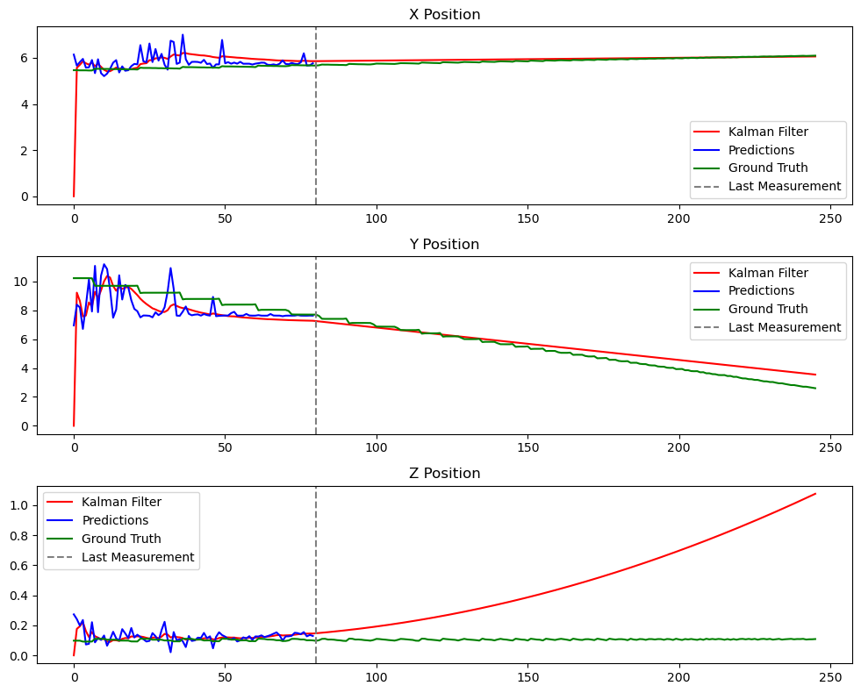

Slide 4

Solution
Essentially it is known that the trajectories have either:
$a_{z}=9.81$ (flying balls)
$a_{z}=0$ (rolling balls)
To incorporate this information into the pipeline:
The measurements are fed into two KF, one with each acceleration
Every timestep, the predicted position of the KF is checked
If the z value is below a certain value (i.e. close to the floor) most of the time, then the KF for rolling balls is used. Otherwise, the one for flying balls is used.

Slide 5
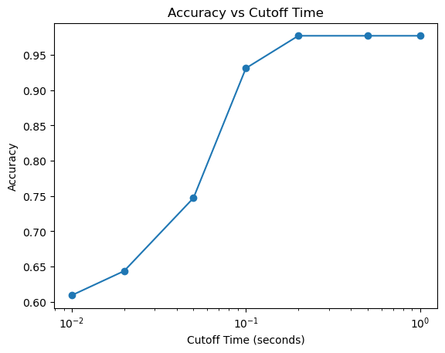
How well does this work?
Just by looking at the ball 0.2 seconds, the achieved accuracy for telling apart flying and rolling balls in the validation dataset is 98%.

Slide 6
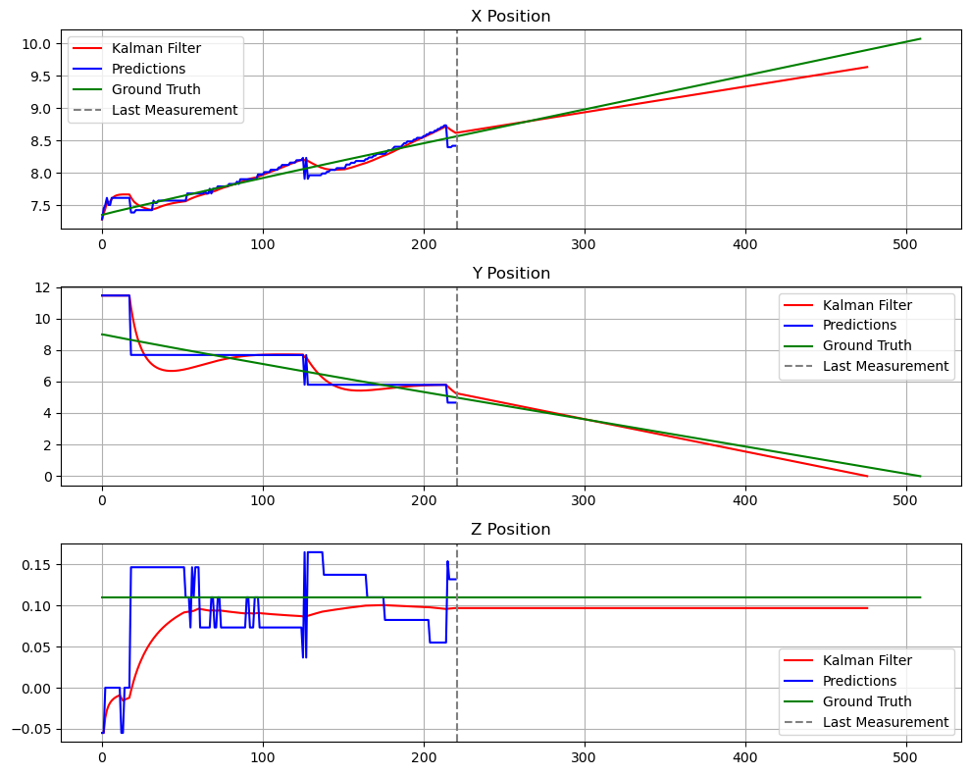
Time to Evaluate
For the evaluation of the Kalman Filter we will follow this pipeline:
Update the filter (we “observe” the ball) until the cutoff time.
Predict until the ball reaches the goal
Compare the predicted position to the true position
The cutoff time will be chosen in two ways:
When the ball has reached a certain distance
When the ball has been looked at for a certain time

Slide 7
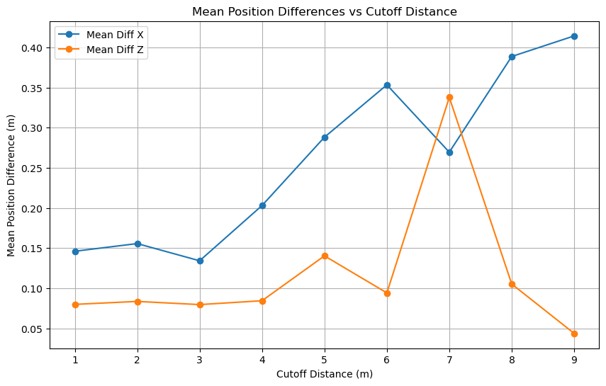
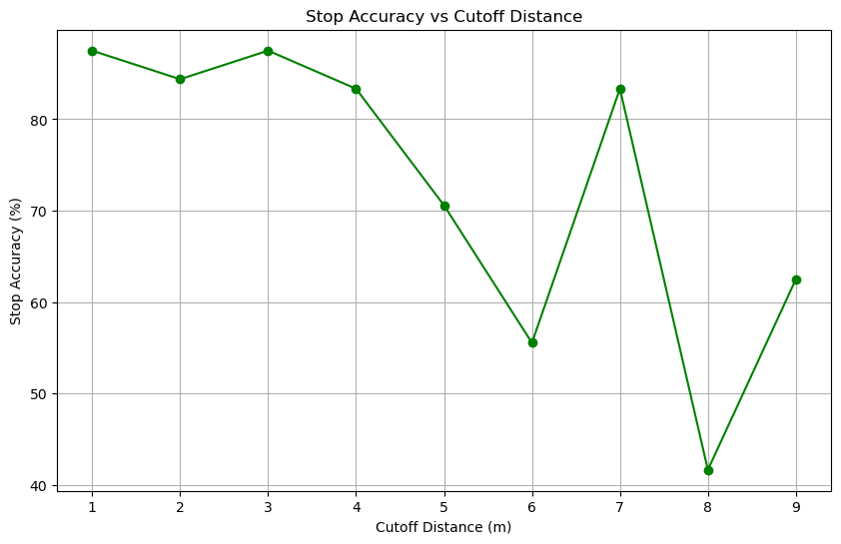
Results in Goal: Cutoff distance
*Stop accuracy: percentage of trajectories for which the predicted position is within 30cm of the actual position

Slide 8
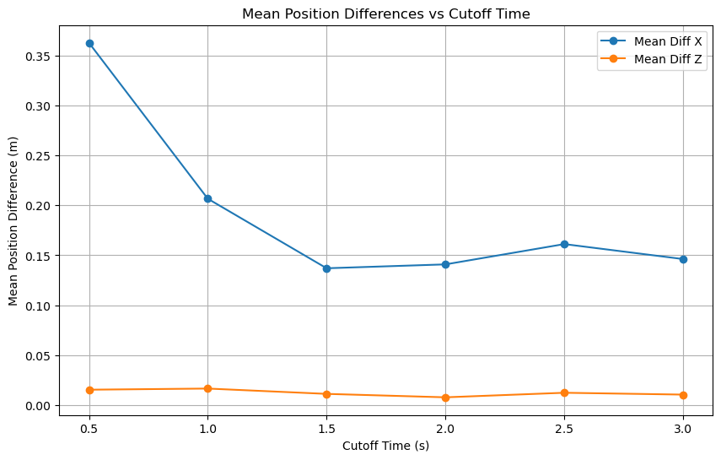
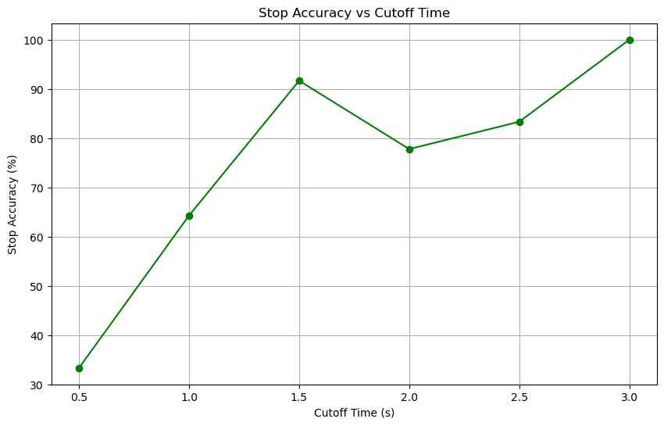
Results in Goal: Cutoff time
*Stop accuracy: percentage of trajectories for which the predicted position is within 30cm of the actual position

Slide 9
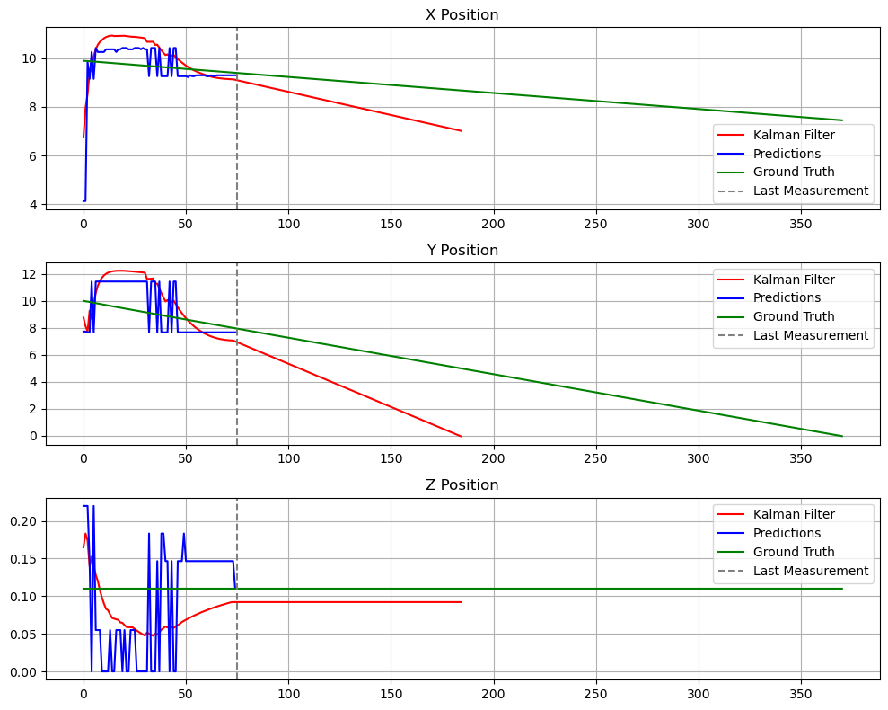
There’s a catch…
Sometimes X and Z positions are right but the time is not right
So we’re going to look into the difference between predicted and true positions after 0.3s from the cutoff time

Slide 10
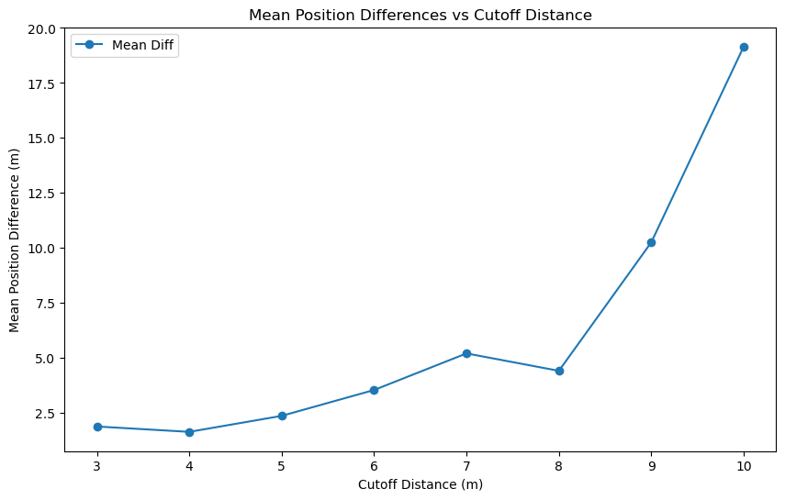
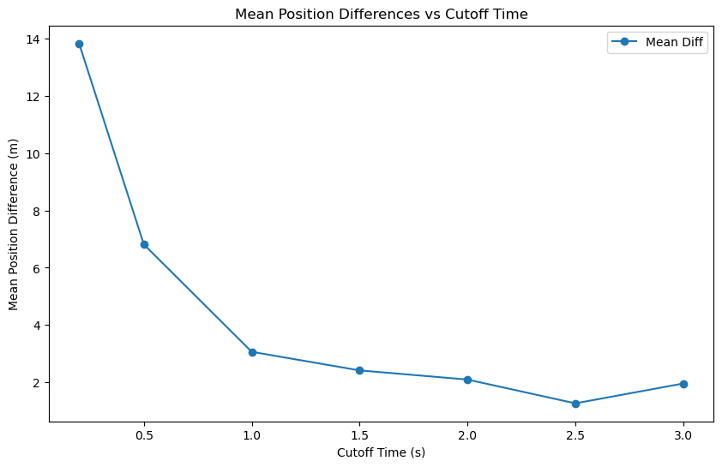
Results after 0.3s

Slide 11
Is it possible to stop the ball?
Latency of the model = 5ms
Accumulation time = 10ms
Accuracy if we stop looking at the ball when it is 4m away from the goal: 83%
If the ball is moving to the goal at 10m/s, it would take 0.4s to reach the ball
This leaves 0.385 s to move the robot to the predicted position
However, the accumulation time could be smaller

